Slide 1


Predicting Conflict
Francesca Savoia and Richard Witt
CSI 777

Slide 2

Can combining conflict data with US defense industrial market data lead to increased prediction accuracy in either data set?

Slide 3
Overview of ACLED
ACLED: Armed Conflict Location & Event Database
ACLED collects and analyzes data on locations, dates, and types of all reported armed conflict and protest events in developing countries
Spans from January 2017-present

Slide 4
Overview of Defense Industrial Sector
Interactive Broker Exchange Service accessed through WRDS
Reduced to stocks in Dow Jones US Select Aerospace & Defense Index as identified by the Exchange traded fund iShares US Aerospace & Defense (ITA)
Size:
14 Companies
6839 Instances
89 Attributes
~ 20 useful attributes
4.7 MB

Slide 5
Steps I took to Analyze ACLED
The relational data from the Armed Conflict Location & Event Data Project was turned into several "Conflict" Undirected Graphs/Networks
The nodes in these graphs are different "agents" in the Middle East defined as the product of an actor type and the country that they operate
The edges in these graphs are defined as follows: 1 if there was at least one conflict during a time period between two agents and 0 otherwise

Slide 6
Steps I took to Analyze ACLED
By using various link prediction/topological features measures, I created features about the edges that exist and don't exist within these graphs
My target (what I am trying to predict) was set as whether a conflict occurred (represented as an edge) within a certain time frame (a month)

Slide 7
Steps I took to Analyze ACLED
code | Category
1 | State Forces
2 | Rebel Groups
3 | Political Militias
4 | Identity Militias
5 | Rioters
6 | Protesters
7 | Civilians
8 | External/Other Forces
I first loaded the dataset from csv files and then organized the data into category codes based on the type of event that occured:

Slide 8
Steps I took to Analyze ACLED
event_date | country | actor1 | actor1_country | actor1_category | actor2 | actor2_country | actor2_category
2022-04-08 | Afghanistan | Unidentified Armed Group (Afghanistan) | Afghanistan | Political Militias | Civilians (Afghanistan) | Afghanistan | Civilians
2022-04-06 | Afghanistan | Unidentified Armed Group (Afghanistan) | Afghanistan | Political Militias | Civilians (Afghanistan) | Afghanistan | Civilians
2022-04-05 | Afghanistan | Unidentified Armed Group (Afghanistan) | Afghanistan | Political Militias | Civilians (Afghanistan) | Afghanistan | Civilians
2022-04-03 | Afghanistan | Unidentified Armed Group (Afghanistan) | Afghanistan | Political Militias | Civilians (Afghanistan) | Afghanistan | Civilians
2022-04-01 | Afghanistan | Unidentified Armed Group (Afghanistan) | Afghanistan | Political Militias | Civilians (Afghanistan) | Afghanistan | Civilians
Determine the set of all countries in the data set
Define all the possible actor countries
Join the interaction lookup to each actor code in order to get the category of actor that they are

Slide 9
Steps I took to Analyze ACLED
event_date | agent1 | agent2 | period
2022-04-08 | Political Militias-Afghanistan | Civilians-Afghanistan | 2022-4
2022-04-06 | Political Militias-Afghanistan | Civilians-Afghanistan | 2022-4
2022-04-05 | Political Militias-Afghanistan | Civilians-Afghanistan | 2022-4
2022-04-03 | Political Militias-Afghanistan | Civilians-Afghanistan | 2022-4
2022-04-01 | Political Militias-Afghanistan | Civilians-Afghanistan | 2022-4
Create a dataframe of all realised conflicts between "Agents"

Slide 10
Steps I took to Analyze ACLED
agent1 | agent2 | pref_attachment | resource_alloc_com | jaccard_coef
State Forces-Afghanistan | State Forces-Afghanistan | 49 | 1.809524 | 0.833333
Rebel Groups-Afghanistan | State Forces-Afghanistan | 49 | 0.666667 | 0.428571
Rebel Groups-Afghanistan | Rebel Groups-Afghanistan | 49 | 1.809524 | 0.833333
Political Militias-Afghanistan | State Forces-Afghanistan | 42 | 0.642857 | 0.500000
Political Militias-Afghanistan | Rebel Groups-Afghanistan | 42 | 0.642857 | 0.500000
For each time period, create a Conflict Graph with the conflicts that happened and didn't happen during that period
Extract the jaccard coefficient, resource allocation and preferential attachment of each potential edge

Slide 11
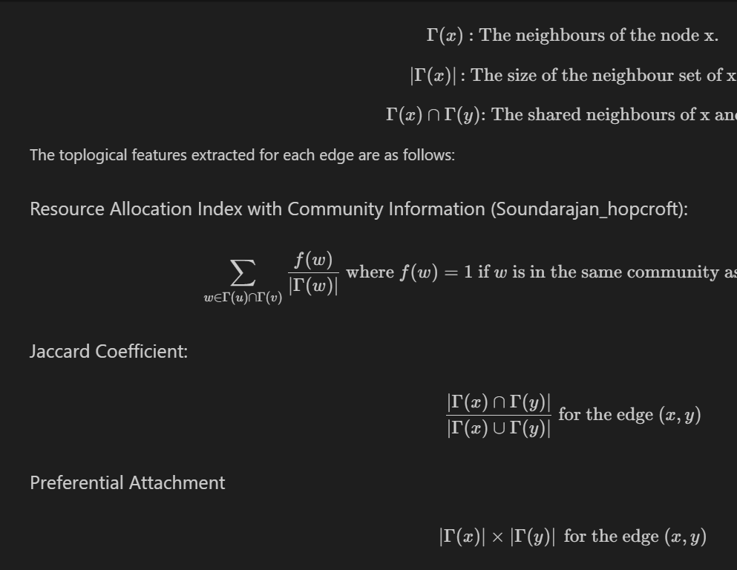
Steps I took to Analyze ACLED
Explanation of the Features that will be extracted:

Slide 12
Steps I took to Analyze ACLED
The goal is:
For each 1-month window of time where conflicts have happened, I extract a data frame where the target is whether a conflict/edge existed during that time frame
I extracted the features that are link prediction measures up to 10 months in the past in 1-month windows

Slide 13
Steps I took to Analyze ACLED
I used a Balanced Random Forest from the imbalanced-learn package
A regular random forest takes random subsamples of the data when constructing each tree, a balanced random forest creates a subsample by up sampling the minority class

Slide 14
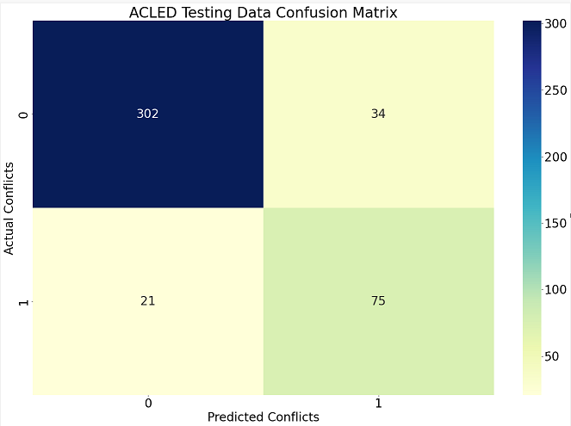
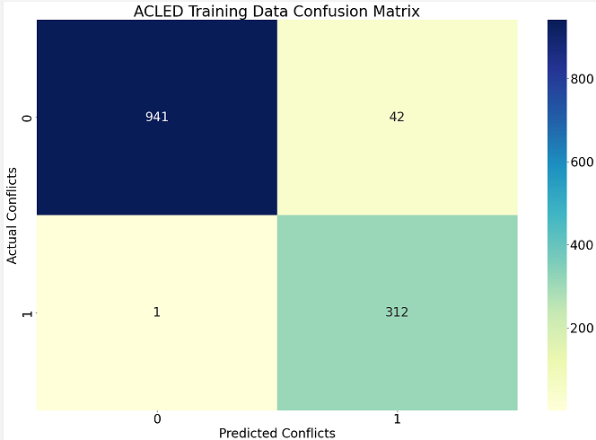
Steps I took to Analyze ACLED
Training data results:
Recall Score (TRAIN): 0.9968051118210862
F1 (TRAIN): 0.9355322338830585
Test data results:
Recall Score (TEST): 0.78125
F1 (TEST): 0.7317073170731707

Slide 15
Combining the Data Results
When I added in the stock price and prior earnings to my dataset, it did not affect my results in predicting a conflict

Slide 16
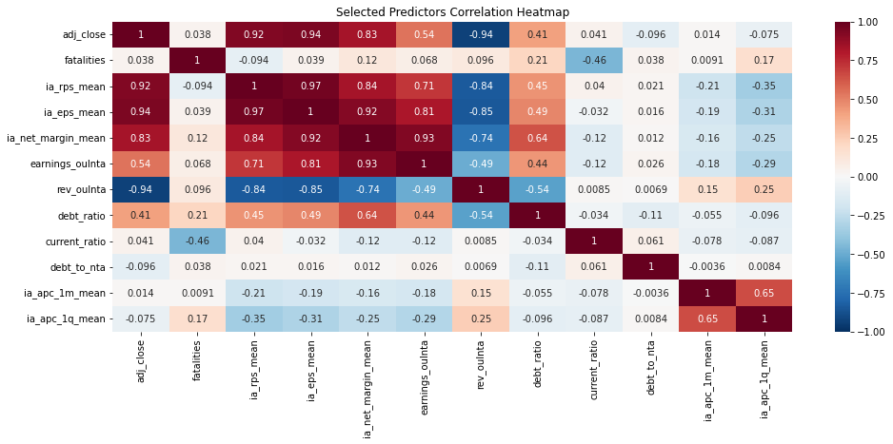
Defense Industrial Sector Analysis
Several Variables with high price (adj_close) correlation

Slide 17
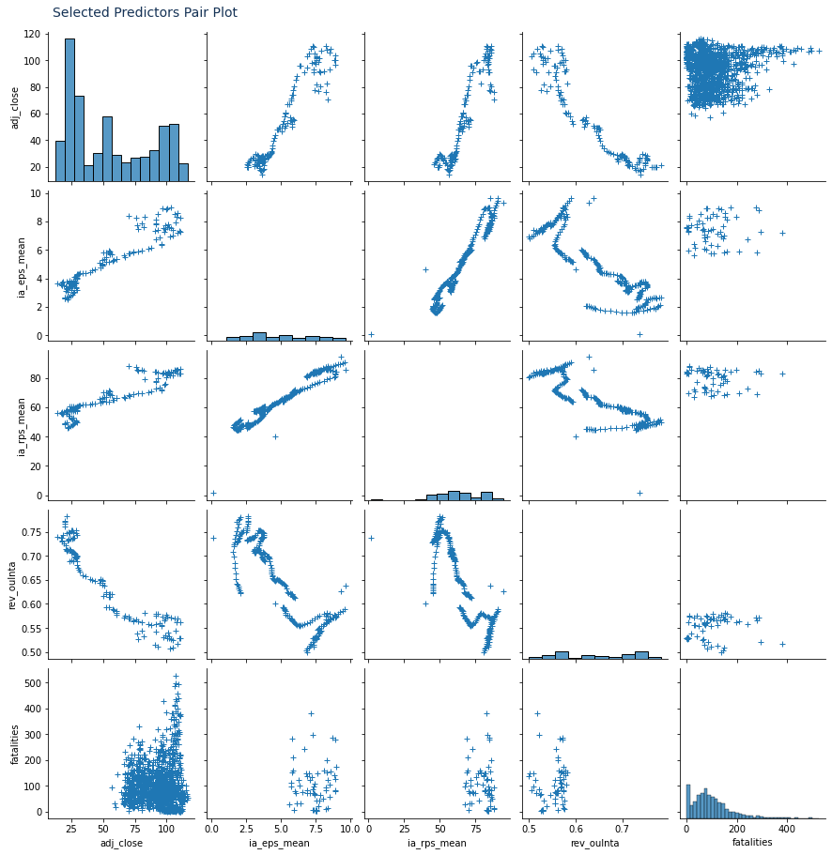
Defense Industrial Sector Analysis
High Correlation Explored
Earnings per Share (EPS) and revenue per share (RPS)
Fatalities show little correlaiton

Slide 18
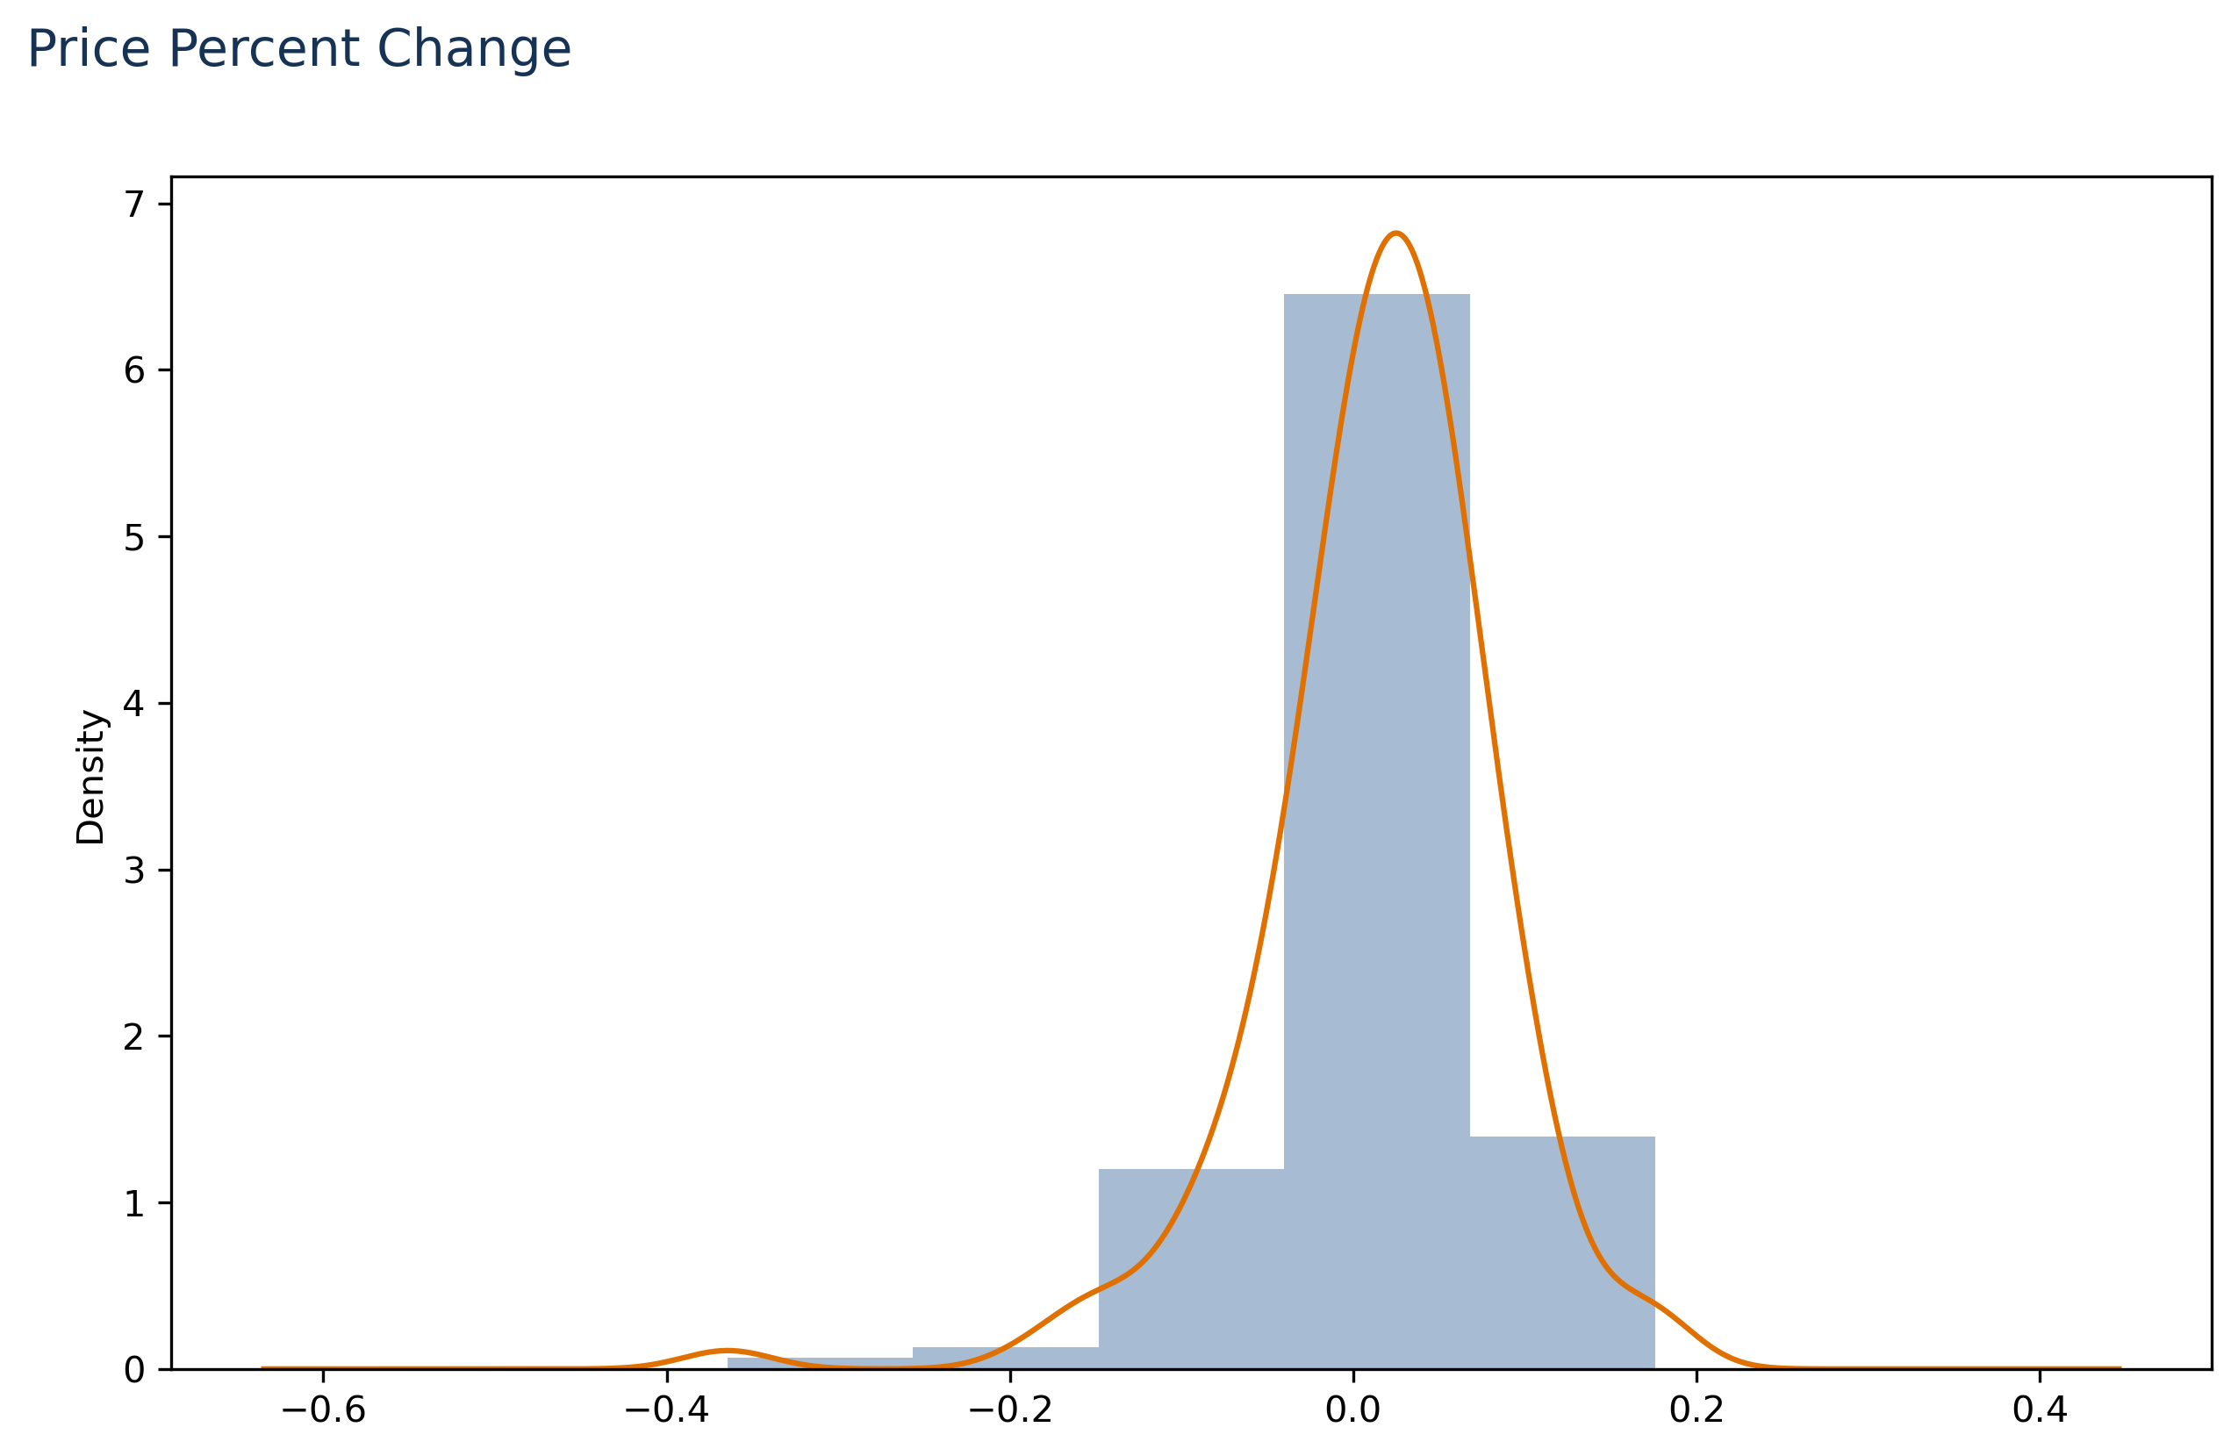
Defense Industrial Sector Analysis
Price data transformed to 5 categories based on percent change
'big_loss’,
'loss’,
'even’,
'gain’,
'big_gain'

Slide 19
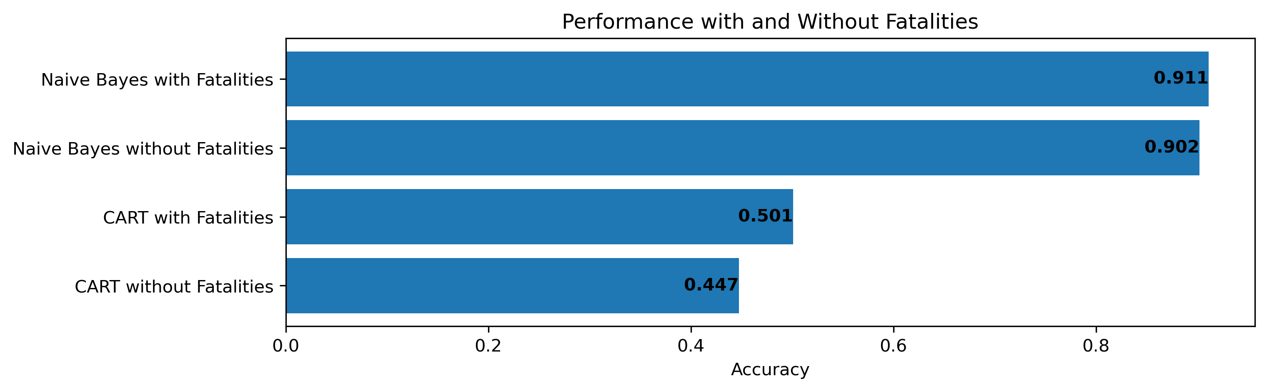
Defense Industrial Sector Analysis
Methodology
CART Decision Tree and Naïve Bayes used
10 Fold Cross Validation accuracy score used to compare
Both libraries sourced from Scikit-learn

Slide 20
Defense Industrial Sector Analysis
Discussion
All variables outperform selected variable subset
Naïve Bayes outperforms CART
Nothing Outperforms ‘select highest frequency’ (0.94)
Neither pass ttest for statistical significance between means (Bayes pval = 0.84, and CART pval = 0.63)
Similar results with monthly resampling

Slide 21
Defense Industrial Sector Analysis
Results
No statistically significant difference between combined dataset and original (finance data only) data set.
No real predictive accuracy in either

